Slide 1


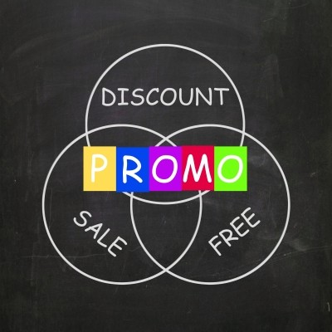

Analyzing ATLIQ Mart Promotions for Tangible Sales Insights (FMCG Domain)
Presented By: Tariq Abbasi

Slide 2
Analyzing FMCG Promotions for Tangible Sales Insights
Atliq Mart is a leading retail giant with 50+ supermarkets in southern India
All 50 stores conducted extensive promotions during Diwali 2023 and Sankranti 2024.
Sales Director Bruce Haryali seeks insights into promotion performance for informed decisions
The primary objective is to identify the promotions that performed well and those that did not, enabling informed decision-making strategies for next promotional period.
Identify factors contributing to the effectiveness of each promotion

Slide 3
Key Performance Indicators and Factors
Store Performance Analysis: This analysis is about the city & store performance analysis for different stores of Atliq Mart in different cities. This view helps giving important insights & performance impact on stores due to different campaign of promotions.
Promotion Type Analysis: This View is all about the impact of promotion offers on various categories, city, products, campaigns. It will help to Identify factors contributing to the effectiveness of each promotion. overall gives us the idea about the customer responses on different promotion schemes.
Product and Category Analysis: This analysis provides insights for informed decision-making about the distribution of promotion revenue by category , sales and revenue in future promotional planning

Slide 4
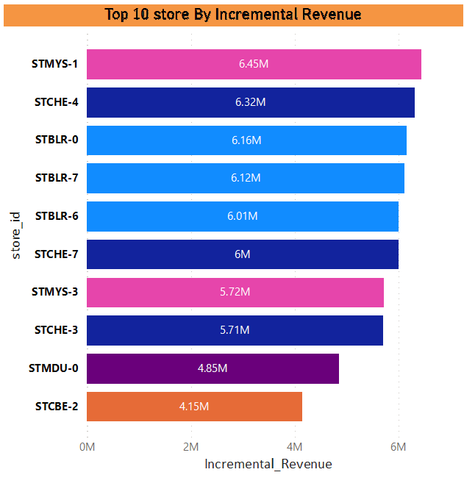
Store Performance Analysis
Store in city Mysore generated the highest incremental revenue of 6.45M from the promotion with the first position while store in Chennai on the second position with incremental revenue of 6.32M
Noticeably, Chennai and Bangalore generated 3 stores each with incremental revenue in top 10 store while Mysore city features only 2 stores with IR

Slide 5
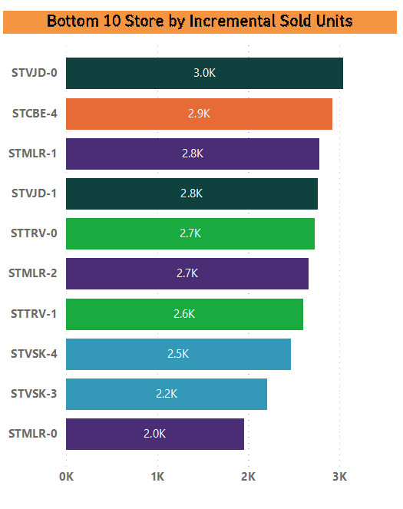
Store Performance Analysis
Mysore city also has one store that performed very bad in terms of Incremental sold units of 2.0k
Visakhapatnam also featured with 2nd and 3rd lowest stores in terms of ISU with 2.2k and 2.5k
Noticeably, Mysore generated 3 stores each with lowest incremental sold units in botom10 store while Visakhapatnam and Trivandrum features 2 stores each in the 10 lowest incremental sold units

Slide 6
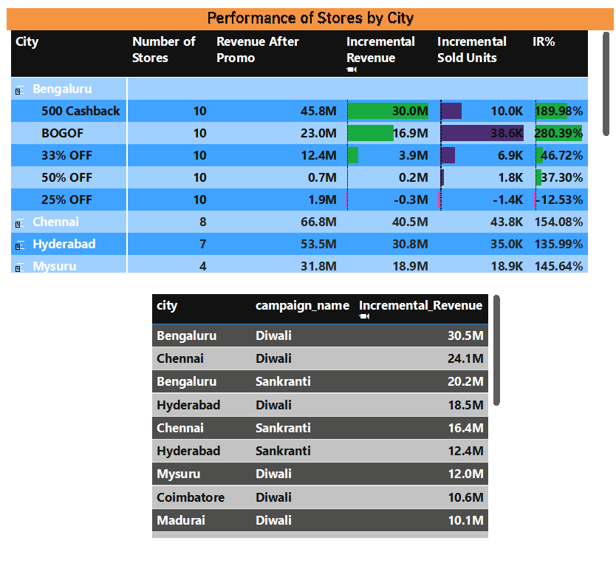
Store Performance Analysis
Top Performing Cities:
Bengaluru
Chennai
Hyderabad
Common Characteristics:
Number of store in each city
Quantity sold after promo
BOGOF promo performance
Cashback promo performance
Diwali campaign works better than Sankranti

Slide 7
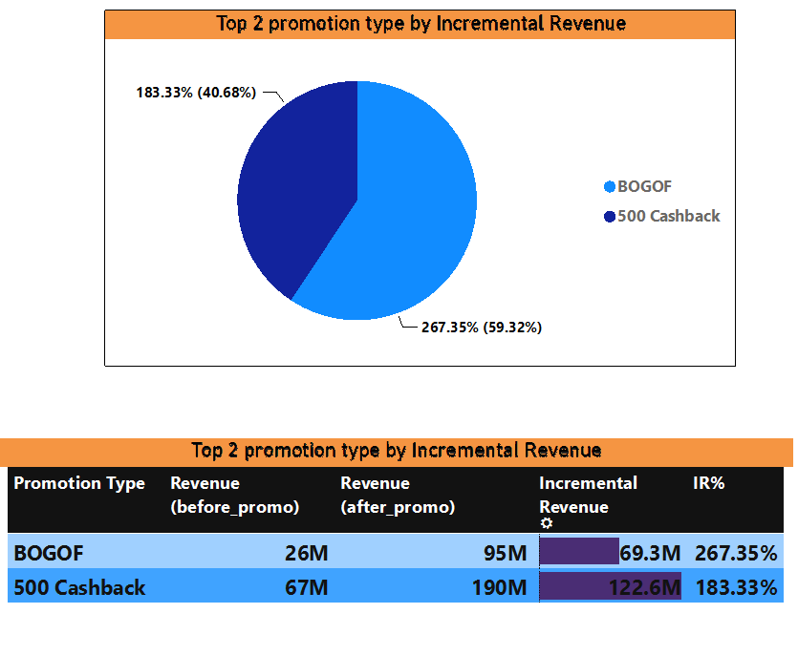
Promotion Type Analysis
Top 2 promotion type in terms of Incremental Revenue are BOGOF and Cashback with incremental revenue of 69.3M(267.35%) and 122.6M(183.33%) respectively

Slide 8
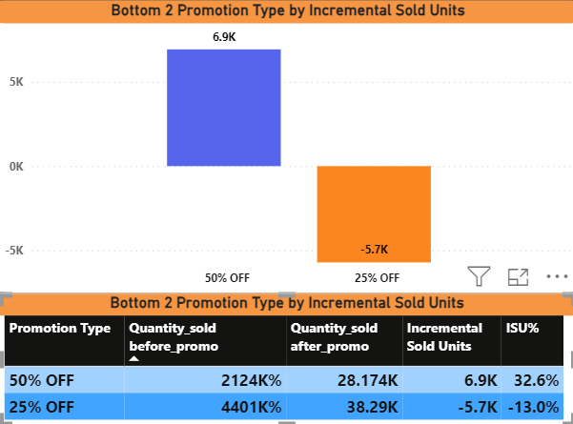
Promotion Type Analysis
The bottom two promotions which impacted very less by incremental sold units are 50% and 25% discount offer. these two promotions generated the impact on sold units 6.9K and -5.7K respectively
25% discount based promotion generated negative impact on sold units around -13% in total while 50% discount based promotion did +32.6%

Slide 9
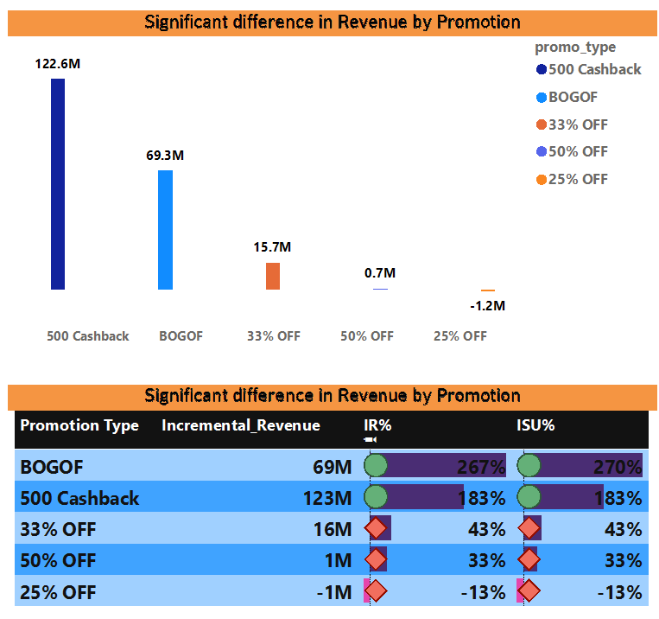
Promotion Type Analysis
Discount based promotions generated 16M in combine
While BOGOF did 69.3M only that is the increment of revenue 267% as compare to previous revenue before the promotion
On the other hand, cashback promotion generated revenue of 122.6M and increment is 183%

Slide 10
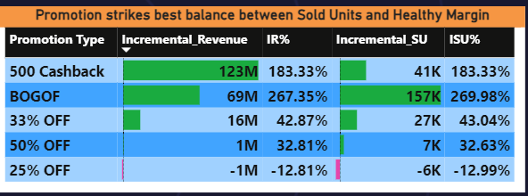
Promotion Type Analysis
BOGOF promotion type strikes the best balance between Sold Units and Healthy Margin with 41K of Incremental sold units and 69M incremental revenue.
The Cashback promotion type strikes the best balance between Sold Units and Healthy Margin with 157K of Incremental sold units and 123M incremental revenue.
The 33% discount promotion type strikes the best balance between Sold Units and Healthy Margin with 27K of Incremental sold units and 16M incremental revenue.

Slide 11
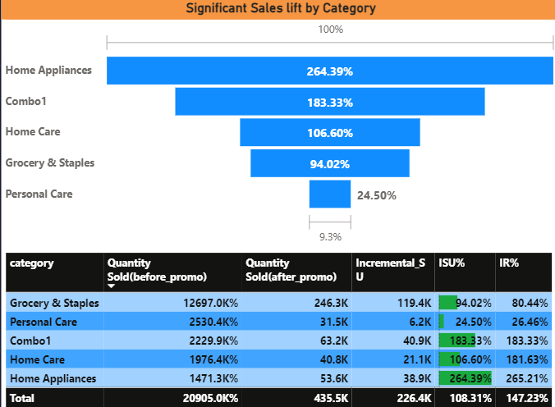
Product and Category Analysis
Home Appliances saw the significant lift in sales after promotion 264% with the Incremental Sold unit of 38.k which more than item sold before the promotion. Followed by Combo1 and Home Care with 183.33% and 107.60%
Grocery and Staples saw the significant lift in sales after promotion on 4th position with the Incremental Sold unit of 94.02%

Slide 12
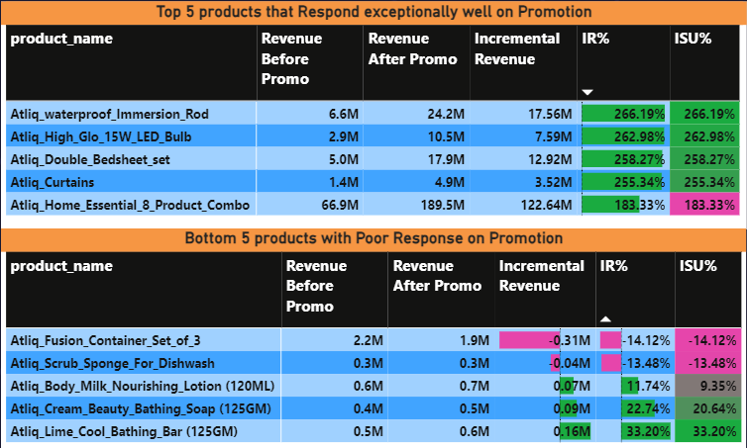
Product and Category Analysis
Atliq_waterproof_immersion_Rod with base price 1020 and Atliq_High_ Glo_LED_bulb with price 350 performed Exceptionally good with High Growth
on the other side, Atliq_Fusion_container_set_3 and Atliq_Scrub_Sponge_For_Dishwash performed Exceptionally poor with negative Growth

Slide 13
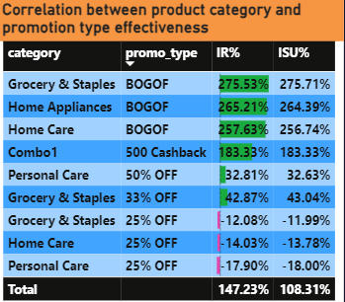
Product and Category Analysis
Correlation is a statistical measure that express how two variables are dependent or related to performance each other.
The correlation between the product category and promotion type effectiveness shows that categories paired with promotion type of "BOGOF" and "Cashback" performed well in terms of Incremental revenue and Incremental Sold Units both as compared to other promotion types. It means categories related with specific promotion types increased the effectiveness in IR and ISU.

Slide 14
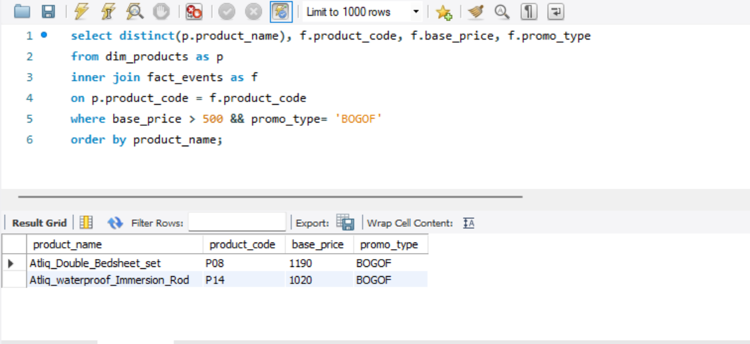
Ad-hoc Business Requests
Business question 1
select distinct(p.product_name), f.product_code, f.base_price, f.promo_type
from dim_products as p
inner join fact_events as f
on p.product_code = f.product_code
where base_price > 500 && promo_type= 'BOGOF'
order by product_name;

Slide 15
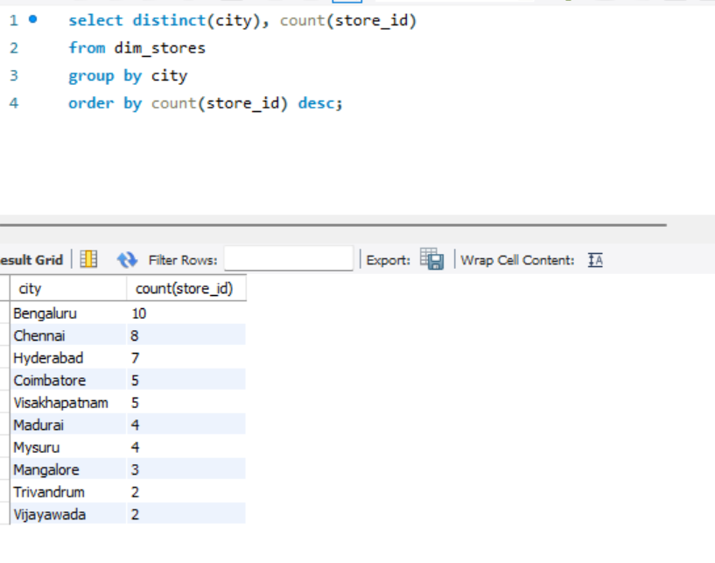
Ad-hoc Business Requests
Business question 2
select distinct(city), count(store_id)
from dim_stores
group by city
order by count(store_id) desc;

Slide 16
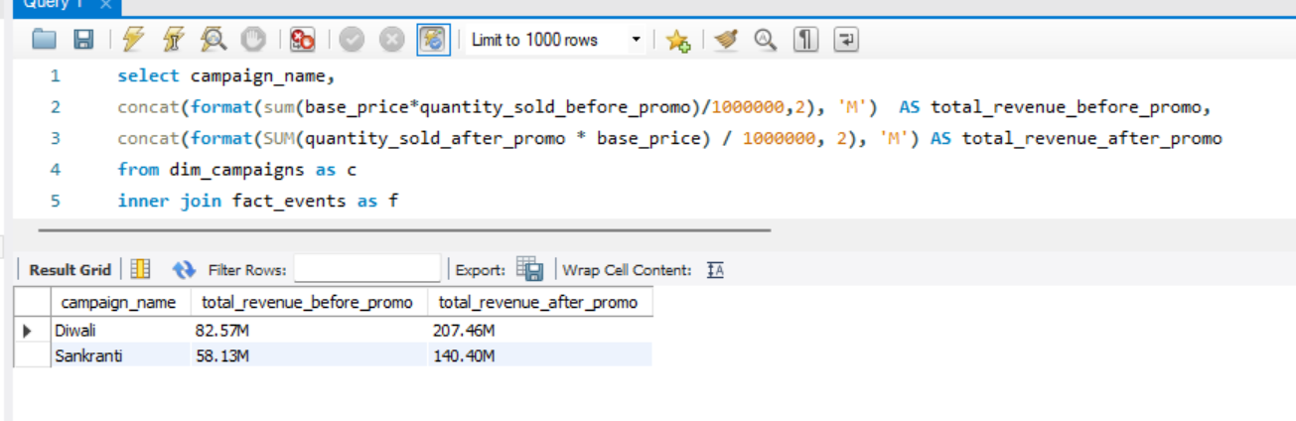
Ad-hoc Business Requests
Business question 3
select campaign_name,
concat(format(sum(base_price*quantity_sold_before_promo)/1000000,2), 'M') AS total_revenue_before_promo,
concat(format(SUM(quantity_sold_before_promo * base_price) / 1000000, 2), 'M') AS total_revenue_after_promo
from dim_campaigns as c inner join fact_events as f on
c.campaign_id = f.campaign_id
group by campaign_name order by campaign_name asc;

Slide 17
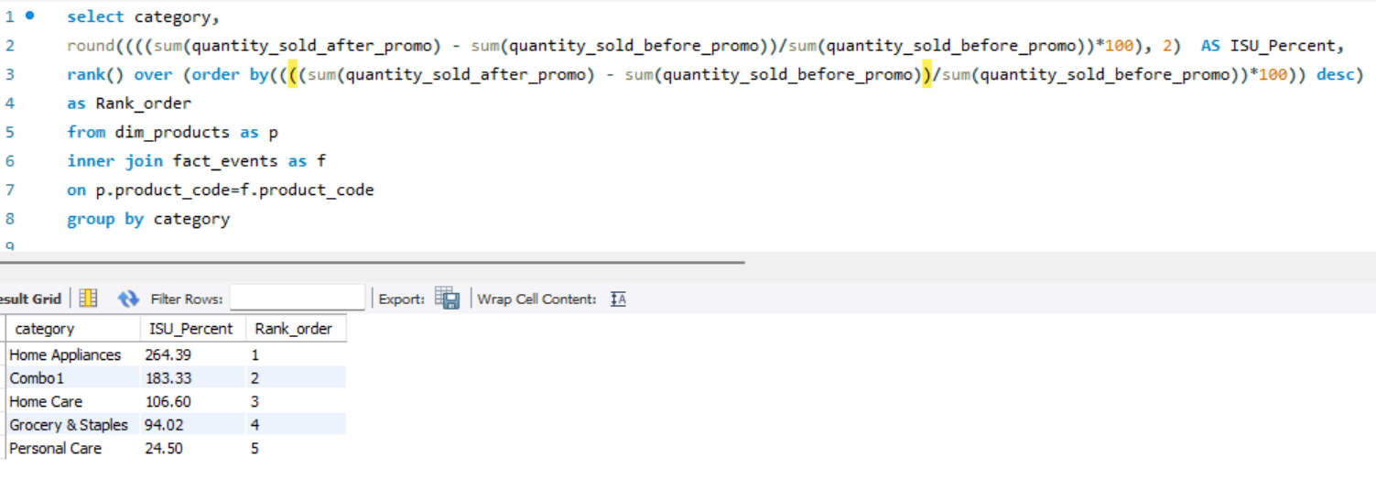
Ad-hoc Business Requests
Business question 4
select category, round(((sum((quantity_sold_after_promo) - sum(quantity_sold_before_promo))/sum(quantity_sold_before_promo))*100), 2) AS ISU_Percent,rank() over (order by((((sum(quantity_sold_after_promo) - sum(quantity_sold_before_promo))/sum(quantity_sold_before_promo))*100)) desc) as Rank_order from dim_products as p inner join fact_events as f on p.product_code=f.product_code group by category

Slide 18
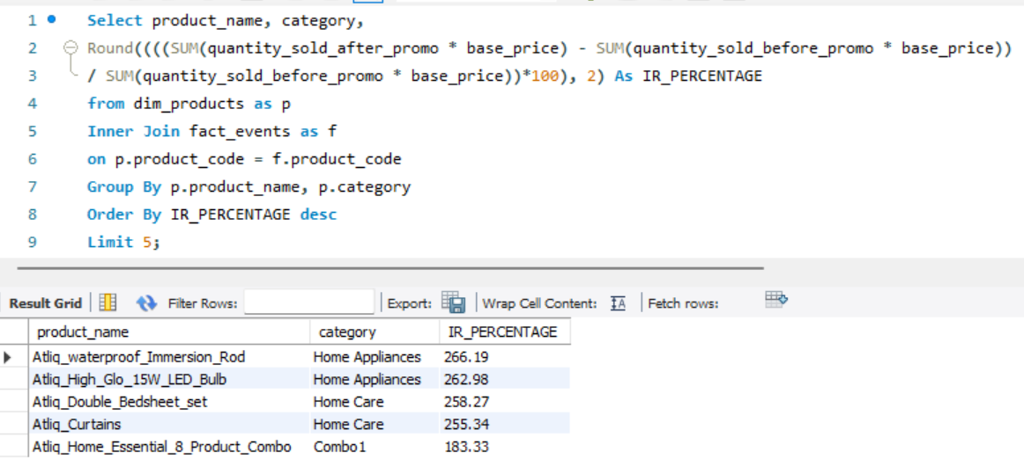
Ad-hoc Business Requests
Business question 5
Select product_name, category,
Round((((SUM(quantity_sold_after_promo * base_price) - SUM(quantity_sold_before_promo * base_price)) / SUM(quantity_sold_before_promo * base_price))*100), 2) As IR_PERCENTAGE from dim_products as p Inner Join fact_events as f on p.product_code = f.product_code Group By p.product_name, p.category Order By IR_PERCENTAGE desc Limit 5

Slide 19
Recommendations
Focus on the customer engagement and retention strategies to boost the sale and revenue. Further, pricing need to be adjusted and marketing strategies need to be tailored for responsive product categories.
According to the store performance in Bengaluru, Chennai and Hyderabad, Increase the number of stores in other cities, especially in cities like Vijayawada and Trivandrum
Mysore city has the one store with the maximum revenue generation but also has three stores in the list of 10 bottom stores in terms of ISU. So need to implement the customer engagement and common characteristics
Ensure the extra stock of top performing products in stores and priorities them in upcoming promotional season
Introduced the BOGOF and Cashback offers regularly in low performing stores to attract more customers
Dedicate a team to do marketing during Diwali duration for Incremental sold units to maximize the revenue in promotional period to attract more customer and sale

